Slide 1
Social network proposal

Slide 2
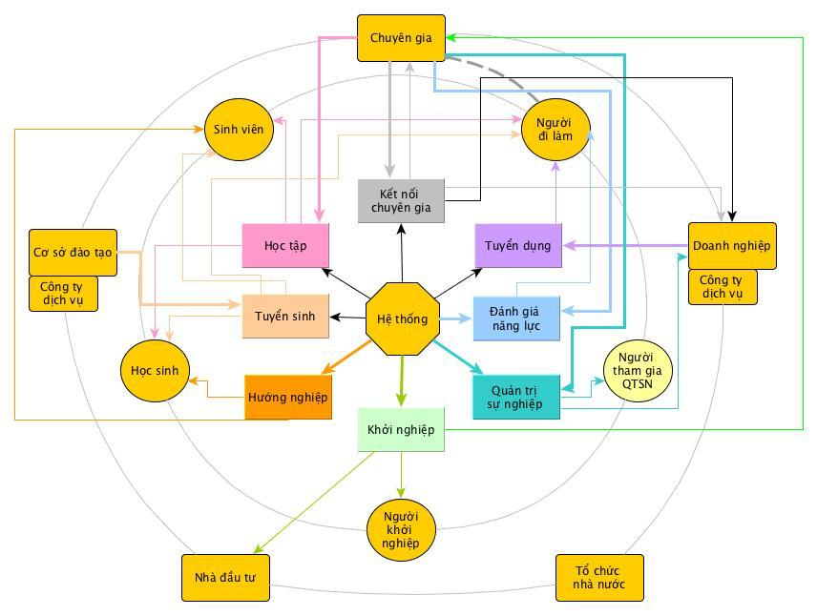
Problem

Slide 3
Challenges
Huge number concurrent transaction (1M records processing/s)
Real time processing
High adaptive architecture
Scalable system
Continuous integration/delivery

Slide 4



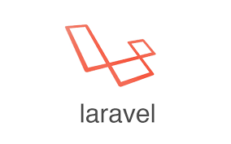







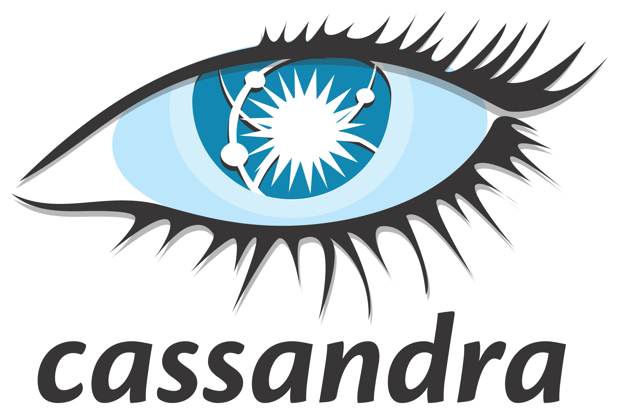

Overall Architecture
Client layer
Business Layer
Storage Layer

Slide 5
Social network
Client: AngularJS, iOS, Android
Server side: PHP Laravel
Database: Apache Cassandra

Slide 6
Business modules (plugin)
Client: AngularJS, iOS, Android
Server side: Java Spring Boot
Database: PostgreSQL

Slide 7

Typical flow
Service hướng nghiệp
Business data
User behaviour data
PostgreSql
Apache Kafka
Apache Storm
Apache Solr/ Elasticsearch
Apache Cassandra

Slide 8
Software architecture
Microservices
Strong Module Boundaries
Independent Deployment
Technology Diversity
Notes:
Challenge #3
Each service manages its own database and any other service must go through the service's API to get at it. This eliminates Integration Databases, which are a major source of nasty coupling in larger systems.

Slide 9
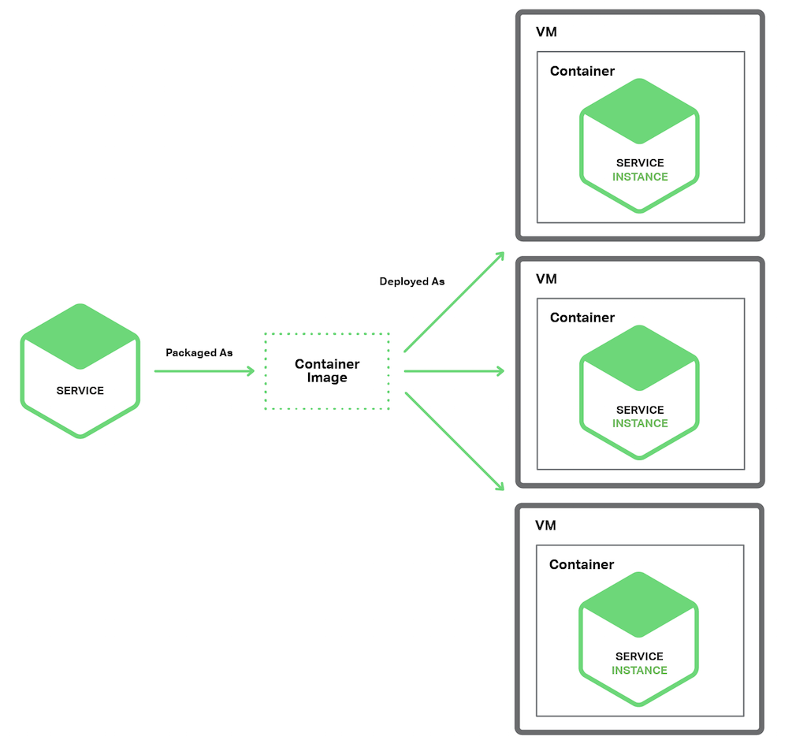
Microservices deployment
Service Instance per Container
Notes:
Containers are a virtualization mechanism at the operating system level. A container consists of one or more processes running in a sandbox. Examples of container technologies include Docker and Solaris Zones.
Container images are typically very fast to build

Slide 10

Laravel
Clean architecture
Composer friendly
Mvc
Dependency injection

Slide 11

AngularJS
Great mvc
Restful
Backed by google
Two-way data binding (automatically synchronizes data (view) with JavaScript objects (model) )
Dependency injection

Slide 12
Apache Cassandra
Being used at eBay, GitHub, GoDaddy, Instagram, Apple, Netflix, Reddit, and over 1500 more companies that have large, active data sets.
Data is automatically replicated to multiple nodes for fault-tolerance.
Performant
Decentralized
Durable
Notes:
One of the largest production deployments is Apple's, with over 75,000 nodes storing over 10 PB of data
Replication across multiple data centers is supported. Failed nodes can be replaced with no downtime.
Cassandra consistently outperforms popular NoSQL alternatives in benchmarks and real applications, primarily because of fundamental architectural choices.
Cassandra is suitable for applications that can't afford to lose data, even when an entire data center goes down.
There are no single points of failure. There are no network bottlenecks. Every node in the cluster is identical.

Slide 13
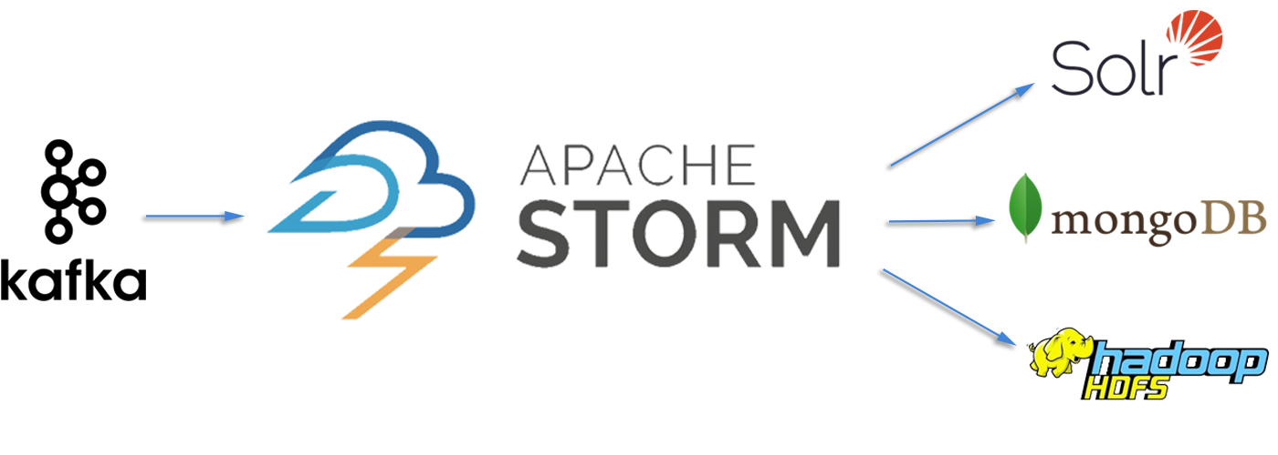
Apache Storm
Created by Twitter
Used by Twitter, Yahoo, Spotify
Real-time processing
1 million records/ second processing

Slide 14
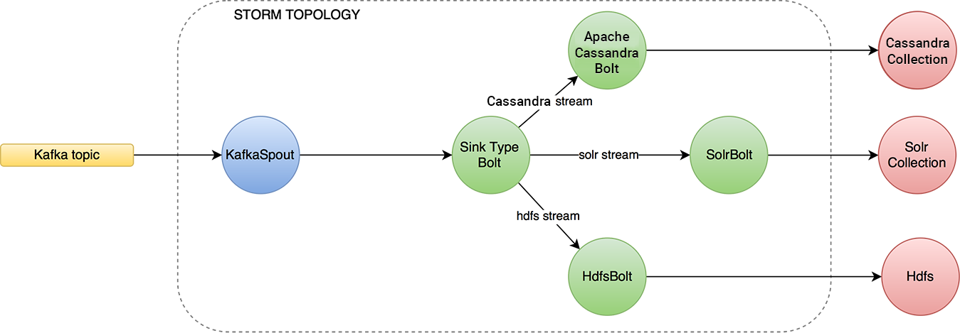
Storm Topology

Slide 15

Apache Spark
Developed by Berkeley University
Used by Baidu, Alibaba, Yahoo, Ebay
Batch/Streaming processing

Slide 16
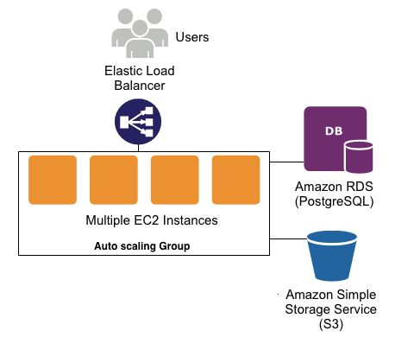
Deployment view
Notes:
Mỗi shard là 1 instance chạy độc lập trên cloud, số lượng tùy thuộc vào config mongodb

Slide 17
Thank you for listening

Slide 18
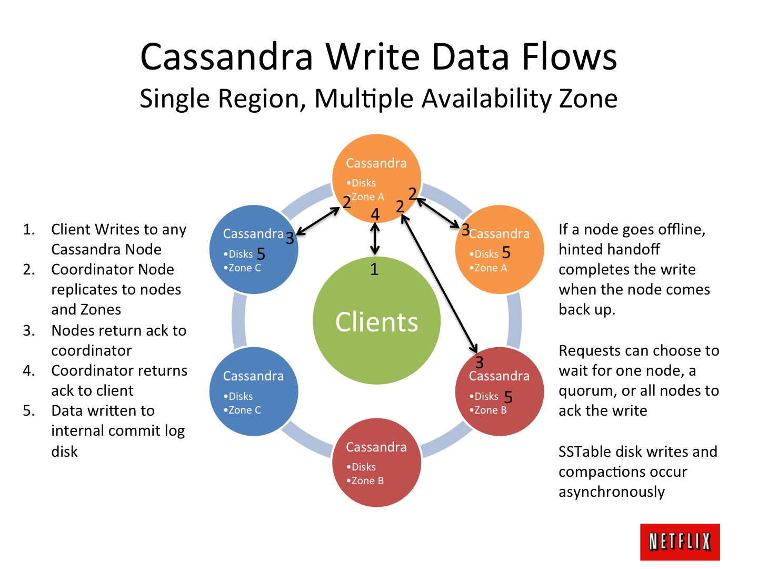

Slide 19
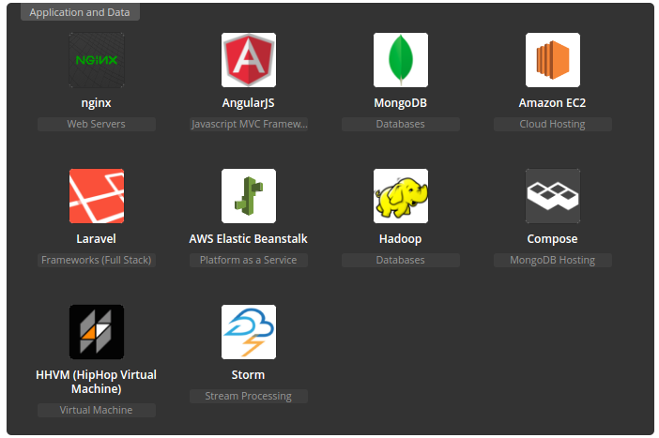
Application and Data

Slide 20
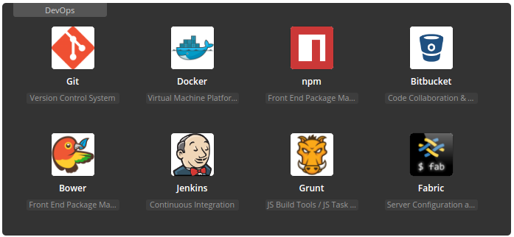
DevOps

